Slide 1
Health insurance cost prediction using machine learning
Muzakkir Qadri Mohammed(110059185)
Statistical Learning(COMP 8590)

Slide 2
Abstract:
Health insurance is a type of insurance coverage that pays for medical and surgical expenses incurred by the insured.
Implementing Machine Learning for Health Insurance estimation can make the Insurance companies have more robust and well made policies.
This Project discusses the various approaches of Supervised Machine Learning in forecasting the Health Insurance costs.
The best Technique observed during experimentation was Gradient Boosting Regressor with R- sqared value of 90%

Slide 3
Introduction:
We live on a planet where health can never be guaranteed due to various unavoidable factors/ risks which may include any physical injuries, accidents ,diseases etc.
The World of Finance has come up with various products and policies to safeguard human disaster while reducing the costs incurred.
These Health Insurance companies are responsible for quantifying the insurance cost estimates as per the policy.

Slide 4
Problem Statement:
Problem Definition: The Quantification of insurance estimates is a tedious task as it requires highly experienced personnel who must consider each and every factor during their computation.
Motivations: If any factor is omitted when the amounts are calculated, the policy changes overall and can lead to fraud or even loss of life.It is therefore critical that these tasks are performed with high accuracy but humans are always bound to make errors.
Justifications: Machine Learning is beneficial as it can automate the process of insurance estimations, thereby reducing human resources and error.

Slide 5
Literature Survey:
Several papers have discussed the issue of claim prediction.
Predict Health Insurance Cost by using Machine Learning and DNN Regression Models by Mohamed Hanafy and Omar M. A. Mahmoud.
This paper discusses about the prediction using 8 techniques i.e., Multiple Linear Regression, Generalized Additive Model, Support Vector Machine, Random Forest Regressor, CART, XGBoost, k-Nearest Neighbors, Stochastic Gradient Boosting, and Deep Neural Network.

Slide 6
Literature Survey:
Health Insurance Amount Prediction by Nidhi Bhardwaj , Rishabh Anand.
This paper discusses about prediction using 3 techniques that are Multiple Linear Regression ,Decision tree regression and Gradient Boosting Regression.
Predicting Health Care Costs using Evidence Regression by Belisario Panay, Nelson Baloian Jose A. Pino, Sergio Panafiel, Horacio Sanson and Nicola Bersano .
This paper discusses about predicting health care costs using evidence regression based on Dampster-Shafer Theory.

Slide 7
Methodology
Material and Data:
The data being used has been obtained from Kaggle.com and it has 1338 Data Items/points.
It has the following predictors:
Age
BMI(Body Mass Index)
The Number of Kids
Gender- Male or Female
Smoker- Yes or No
Region- Southeast, Southwest, Northest, Northwest
Charges

Slide 8
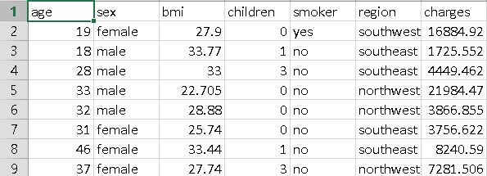
Data

Slide 9
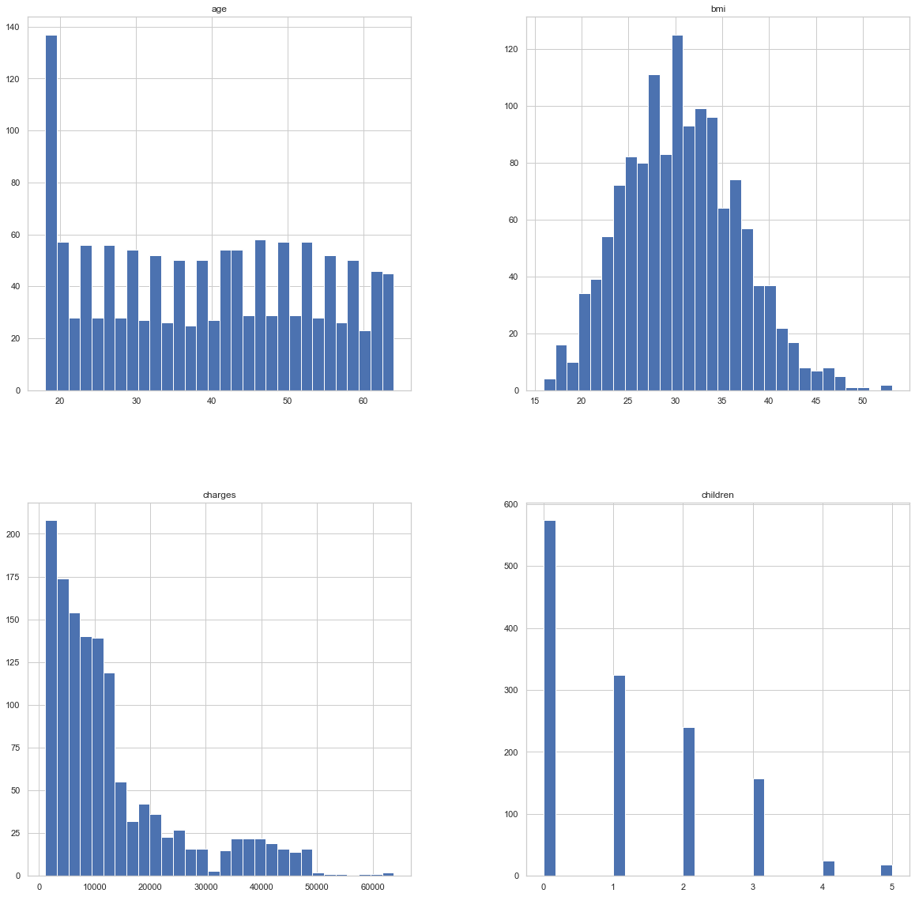
DATA:BEFORE standardization

Slide 10
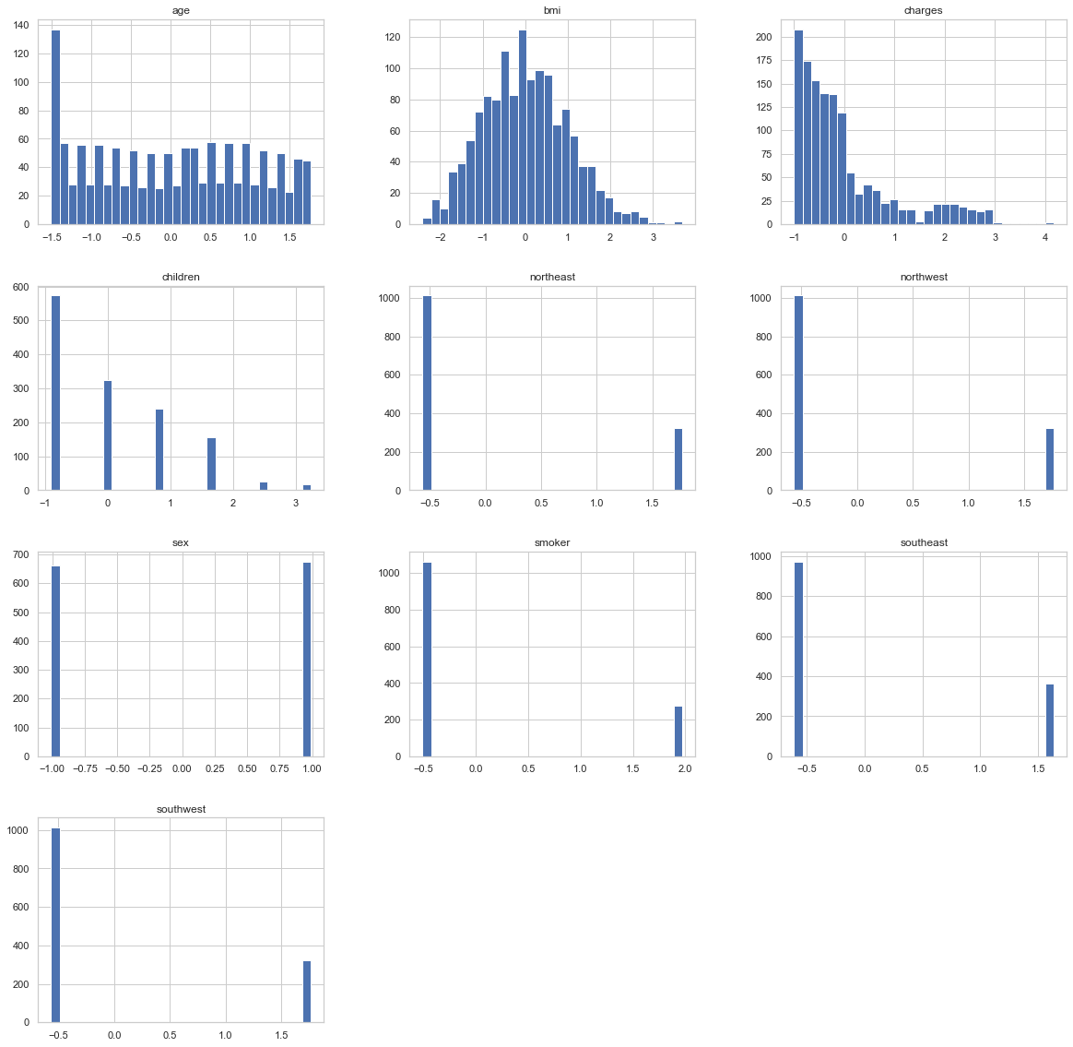
Data: after Standardization

Slide 11
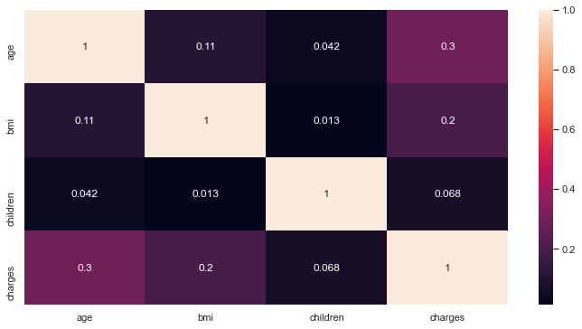
Correlations between predictors

Slide 12
Methodology
Proposed Techniques:
The following 6 supervised Learning Techniques have been Adopted:
Multiple Linear Regression
Support Vector Regressor
Decision Tree Regressor
Random Forest Regressor
Gradient Boosting Regressor
Random Forest Regressor using PCA

Slide 13
Methodology
Conditions and assumptions
Assumption that the Predictors provided in the Dataset are the only Major Factors that affect the Insurance Estimation.
There might be other real time factors that affect the Health thereby affecting Insurance estimations as well.

Slide 14
Libraries:
The libraries used for model implementation are :
scikit-learn
numpy
pandas
The libraries used for Visualization are:
seaborn
matplotlib

Slide 15

Computational Experiments
Evaluation metrics: The following metrics have been used to evaluate the performance of various models:
R- Squared Score: Measure of variance for a dependent variable that is explained by the predictor. The higher the value the better the model fits the data.
$R^{2}$ = 1 - $\frac{RSS}{TSS}$
$where RSS= Residual sum of Square\text{s}$
$where TSS=Total sum of Squares$

Slide 16

Evaluation metrics
Mean Squared Error: Square of Difference between predicted value and actual value. The lower the value the better the model performs.
MSE = $\frac{1}{n}\sum_{i=1}^{n}{{(Y_{i}^{ }−Y_{i}^{^})}^{2}}$
n = Total Number of Data Points
$Y_{i }^{ }$= Observed Values
$Y_{i}^{^}$ = Predicted Values

Slide 17

Evaluation metrics
Root Mean Squared Error : It is the Square root of Mean Square Error. The lower the value the better the model performs.
RMSE = $\sqrt{ \frac{1}{n}\sum_{i=1}^{n}{{(Y_{i}^{ }−Y_{i}^{^})}^{2}}}$
RMSE= $\sqrt{MSE}$

Slide 18

Evaluation metrics
Mean Absolute Error: It is the arithmetic average of the absolute errors. The lower the value the better the model performs.
MAE = $\frac{\sum_{i=1}^{n}{\left|y_{i}−x_{i}\right|}}{n}$
$y_{i}=Prediction$ values
$x_{i}$ = True Values
n= Total number of Data Points

Slide 19
Implementation details:
Data Gathering/Acquisition: Importing Data From CSV file into a Data Frame
Data Preprocessing:
Data Transformation: transforming the regions into 4 separate features.
Standard Scaler : Standardize features by removing the mean and scaling to unit variance.
Data Splitting: Splitting the Data into test and train sets using 25:75 ratio
Model Creation: Creating the 6 proposed models
Model Training: Training the Models by fitting the data to them.
Performance Evaluation: Evaluating performance of using evaluation metrics.

Slide 20
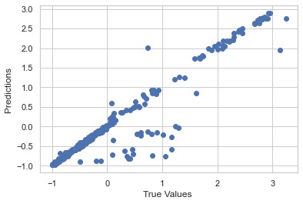
Gradiant boosting Regression

Slide 21
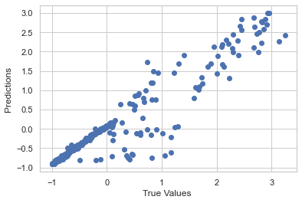
Support Vector Regressor

Slide 22
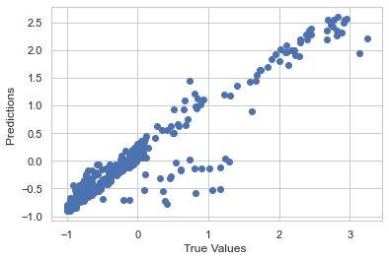
Random Forest Regressor

Slide 23
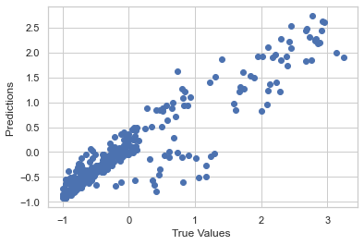
Random Forest Regressor using PCA

Slide 24
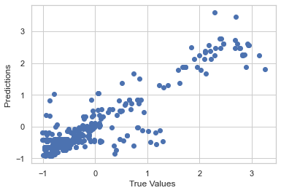
Decision Tree Regressor

Slide 25
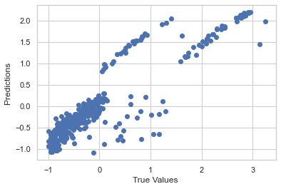
Linear Multiple Regression

Slide 26
Computational Experiments
Results:
Regression Model | MSE | RMSE | MAE | R-Square
Gradient Boosting Regressor | 0.103473 | 0.321672 | 0.122002 | 0.903685
Support Vector Regressor | 0.121008 | 0.347863 | 0.199852 | 0.887362
Random Forest Regressor | 0.122114 | 0.349448 | 0.236742 | 0.886333
Random Forest Regressor using PCA | 0.164342 | 0.405391 | 0.281823 | 0.847027
Decision Tree Regressor | 0.198318 | 0.445329 | 0.289724 | 0.815401
Linear Multiple Regression | 0.219292 | 0.468286 | 0.331479 | 0.795878

Slide 27
Conclusion:
Summary:
Hence by performing various supervised techniques, we have obtained various Machine Learning Models with varying levels of Performance.
The Highest Performance can be observed by the Gradient Boosting Regressor, followed by Support Vector Regressor.
The Performance difference between Support Vector Regressor and Random Forest Regressor is negligible .

Slide 28
Conclusion:
Future Research:
The Employment of more advanced supervised learning methods such as Deep Learning .
Addition of More Features that affect the insurance estimation to perform better predictions.
Open Problems:
The main problem is that only one data set is being used .
More Experiments on various other datasets can provide us more solid evidence on the comparative performance of different algorithms.

Slide 29
References:
Kaggle Medical Cost Personal Datasets. Kaggle Inc. https://www.kaggle.com/mirichoi0218/insurance.
Mohamed Hanafy and Omar M. A. Mahmoud(January 2021) Predict Health Insurance Cost by using Machine Learning and DNN Regression Models (IJITEE)
Nidhi Bhardwaj and Rishabh Anand (June 2020) Health Insurance Amount Prediction (IJERT)
Belisario Panay, Nelson Baloian Jose A. Pino, Sergio Panafiel, Horacio Sanson and Nicola Bersano (November 2019) Predicting Health Care Costs using Evidence Regression (MDPI)

Slide 30
Thank You
ANY QUESTIONS ?

